Slide 1
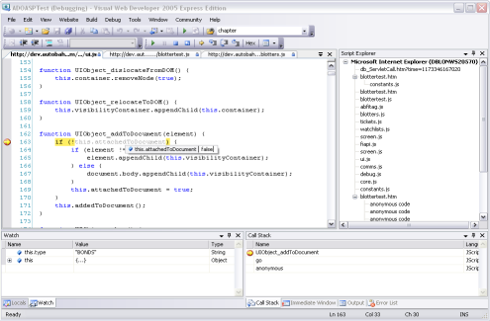



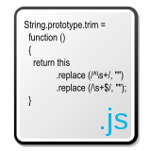
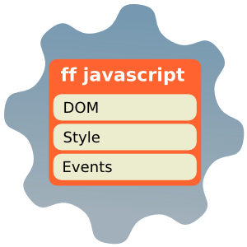

Advanced %JavaScript
http://schoolacademy.telerik.com
Svetlin Nakov
Telerik Corporation
www.telerik.com

Slide 2
Table of Contents (3)
JavaScript OOP
Constructors
Properties
Functions
Inheritance
Polymorphism
Extending Prebuilt JavaScript Objects

Slide 3
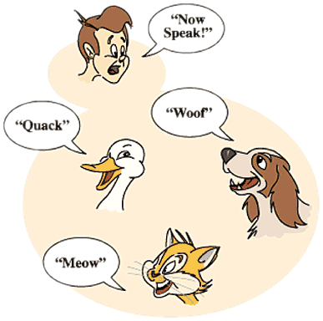

JavaScript OOP
Properties, Functions, Inheritance

Slide 4

JavaScript OOP
The current design of the JavaScript language, did not fully implement the object-oriented paradigms
There are various implementations of object-oriented programming techniques being used on the Web today
Primary goals of OOP
Encapsulation
Polymorphism
Inheritance
Notes:
Defining a Class
Defining and calling Methods in a Class
Defining a Sub-Class
Calling the Super-Class constructor from a Sub-Class
Overriding Methods of a Super-Class in a Sub-Class
Calling a Super-Class method from a Sub-Class

Slide 5
Defining Classes
The simplest way is to use the built-in Object data type
In JavaScript, objects are implemented as a collection of named properties (key-value pairs)
JavaScript allows the creation of any number of properties in an object at any time
They are dynamic – do not have to be pre-defined in an object declaration or constructor
var student = new Object;
student.name= "Doncho Minkov";
student.grade = 3;

Slide 6
Defining a Class with Constructors
A new JavaScript class is defined by creating a function (serving as constructor)
When used with the new operator, a function serves as a constructor for that class
Internally, JavaScript creates an Object, and then calls the constructor function
function Student()
{
this.name = "Doncho Minkov";
this.grade = 3;
}
var student = new Student;

Slide 7
Defining a Class with Constructors (2)
When defining a constructor function, we can make many objects with the same properties
function Student(name, grade)
{
this.name = name;
this.grade = grade;
}
var doncho = new Student("Doncho Minkov", 3);
var pesho = new Student("Pesho Peshov",2 );
var stamat = new Student("Stamat Geshov",4);

Slide 8
Class Functions
We can add a functions (methods) to the class at any time
defining-classes.html
function Student(name, grade)
{
this.name = name;
this.grade = grade;
this.sayHello = function() { alert("Hi! I am " + this.name);
}
}
var doncho = new Student("Doncho Minkov", 3);
doncho.sayHello();

Slide 9
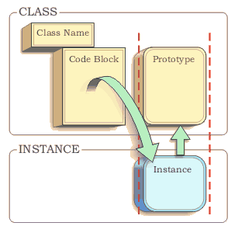

Prototype Object

Slide 10
Object Prototypes
We can use the prototype object to add custom properties / methods to classes
That is reflected on all instances of the class
How to use the prototype object?
Simply reference the keyword prototype on the object before adding the custom property
function Circle() {
}
Circle.prototype.pi = 3.14159;

Slide 11
Object Prototypes (2)
Adding a function to a class at runtime using the prototype object
prototype-object.html
function Circle() {
}
Circle.prototype.pi = 3.14159;
Circle.prototype.radius = 5;
Circle.prototype.calculateArea = function () {
return this.pi * this.radius * 2;
}
var circle = new Circle();
var area = circle.calculateArea();
alert(area); // 31.4159

Slide 12
Prototype Object to Add Functionality to Build-in Classes
Dynamically add a function to a built-in class at runtime using the prototype object:
Attaching a method to the Array class
Array.prototype.showMax =
function () {
var max = this[0];
for (var i = 1; i < this.length; i++) {
if (max < this[i]) {
max = this[i];
}
}
return max;
}
var array = new Array(9, 1, 11, 3, 4);
var max = array.showMax();
alert(max); // 11

Slide 13

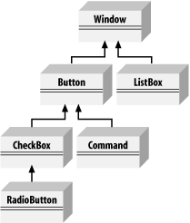
Inheritance and Polymorphism in JavaScript

Slide 14
Inheritance in JavaScript
To inherit a class in JavaScript you should set the prototype object of the subclass to the superclass class:
inheritance.html
function Person(name) {
this.name = name;
this.talk = function () {
alert("Hi! I am " + this.name);
}
}
function Student(name, grade) {
this.name = name;
this.grade = grade;
}
Student.prototype = new Person();
This way we say that the Student class will have all the functionality of the Person class

Slide 15
Polymorphism in JavaScript
Polymorphism = ability to take more than one form (objects have more than one type)
A class can be used through its parent interface
A child class may override some of the behavior of the parent class
polymorphism.html
Student.prototype = new Person();
Teacher.prototype = new Person();
var array = new Array(
new Teacher("Gana","Math"), new Student("Gosho",3),
new Person("Pesho"), new Teacher("Mara","Literature"));
for (var i = 0; i < array.length; i++) {
array[i].talk();
}

Slide 16
Advanced JavaScript
?
?
?
?
?
?
?
?
?
?
?

Slide 17
Homework
Implement a class Human, having name, gender, address, telephone number
It should have a methods for introducing himself (ex. "Hi I am …!", "I am … years old!")
Implement classes Student and Parent inheriting the Human class
A Student should have
State holding where s/he studies, a list of his/her marks
A method to count the average of their marks
A method for adding/removing a mark
A Parent should hold a list of all his children(Student objects) and a method to yell at a concrete of his children

